Slide 1

SMART STADIUM MONITORING SYSTEM

Slide 2
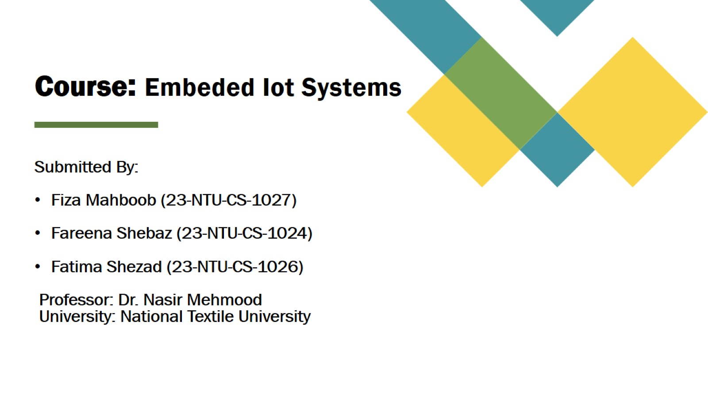
Course: Embeded Iot Systems

Slide 3
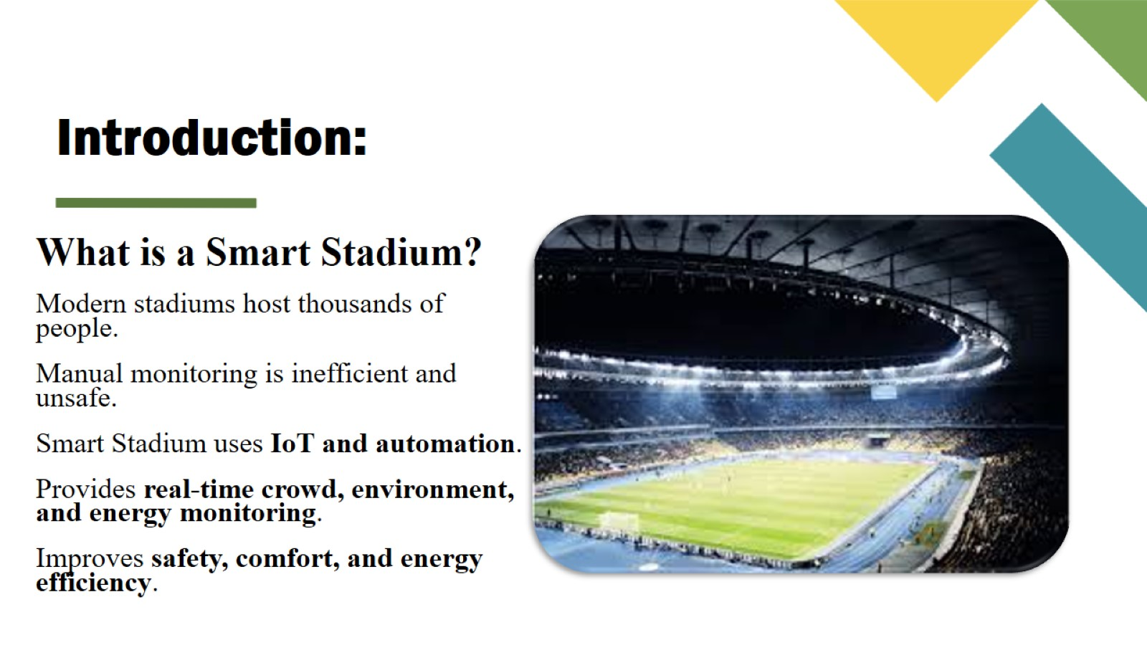
Introduction:

Slide 4
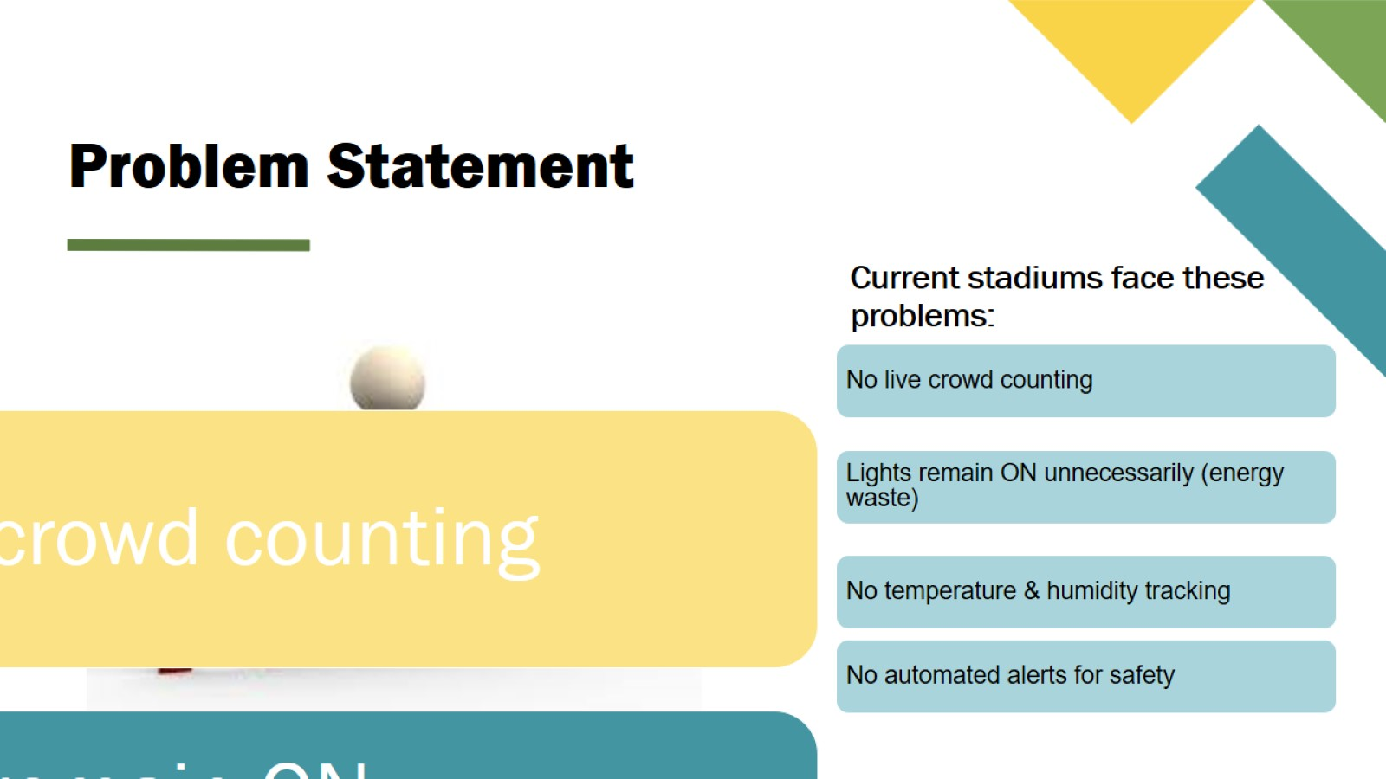
Problem Statement

Slide 5
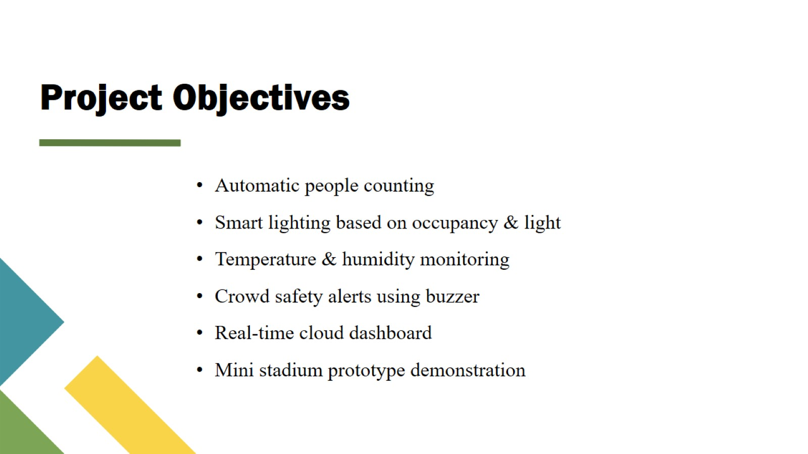
Project Objectives

Slide 6
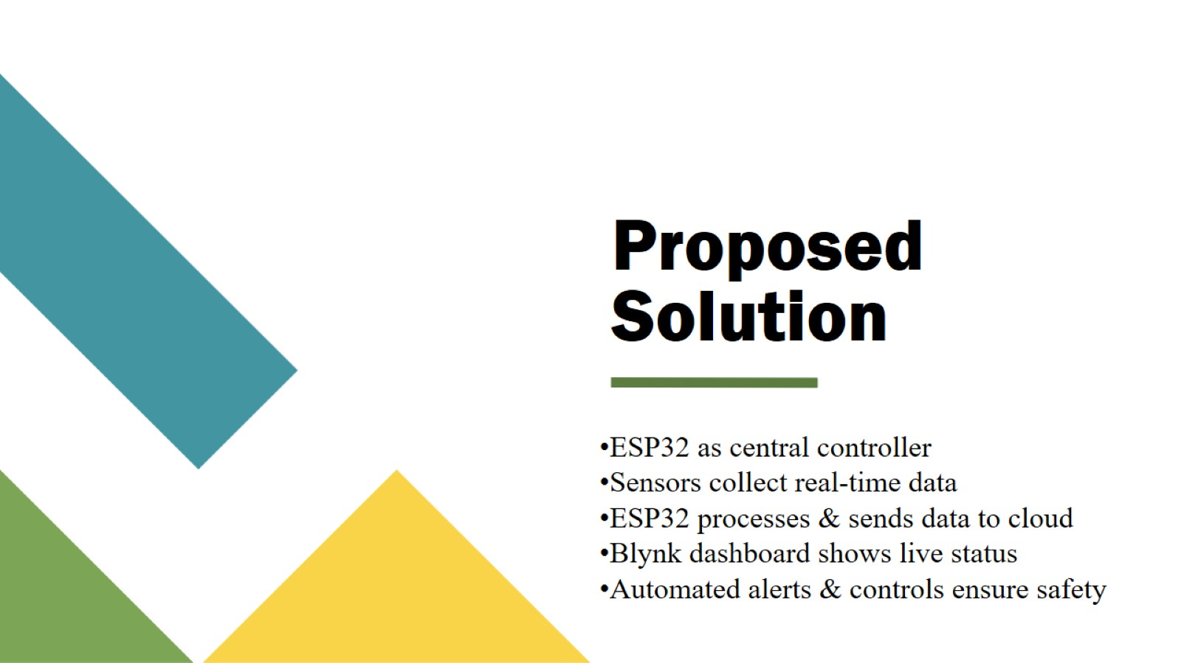
Proposed Solution

Slide 7
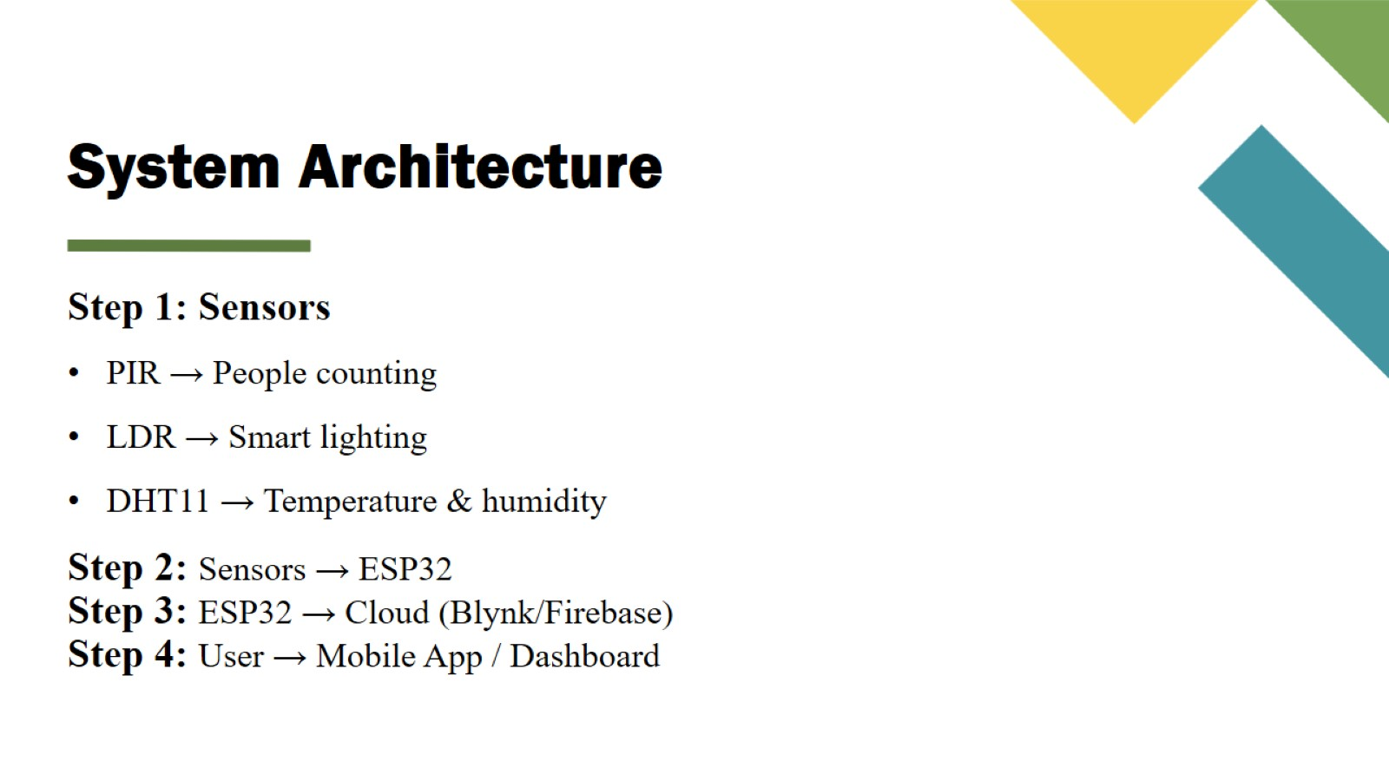
System Architecture

Slide 8
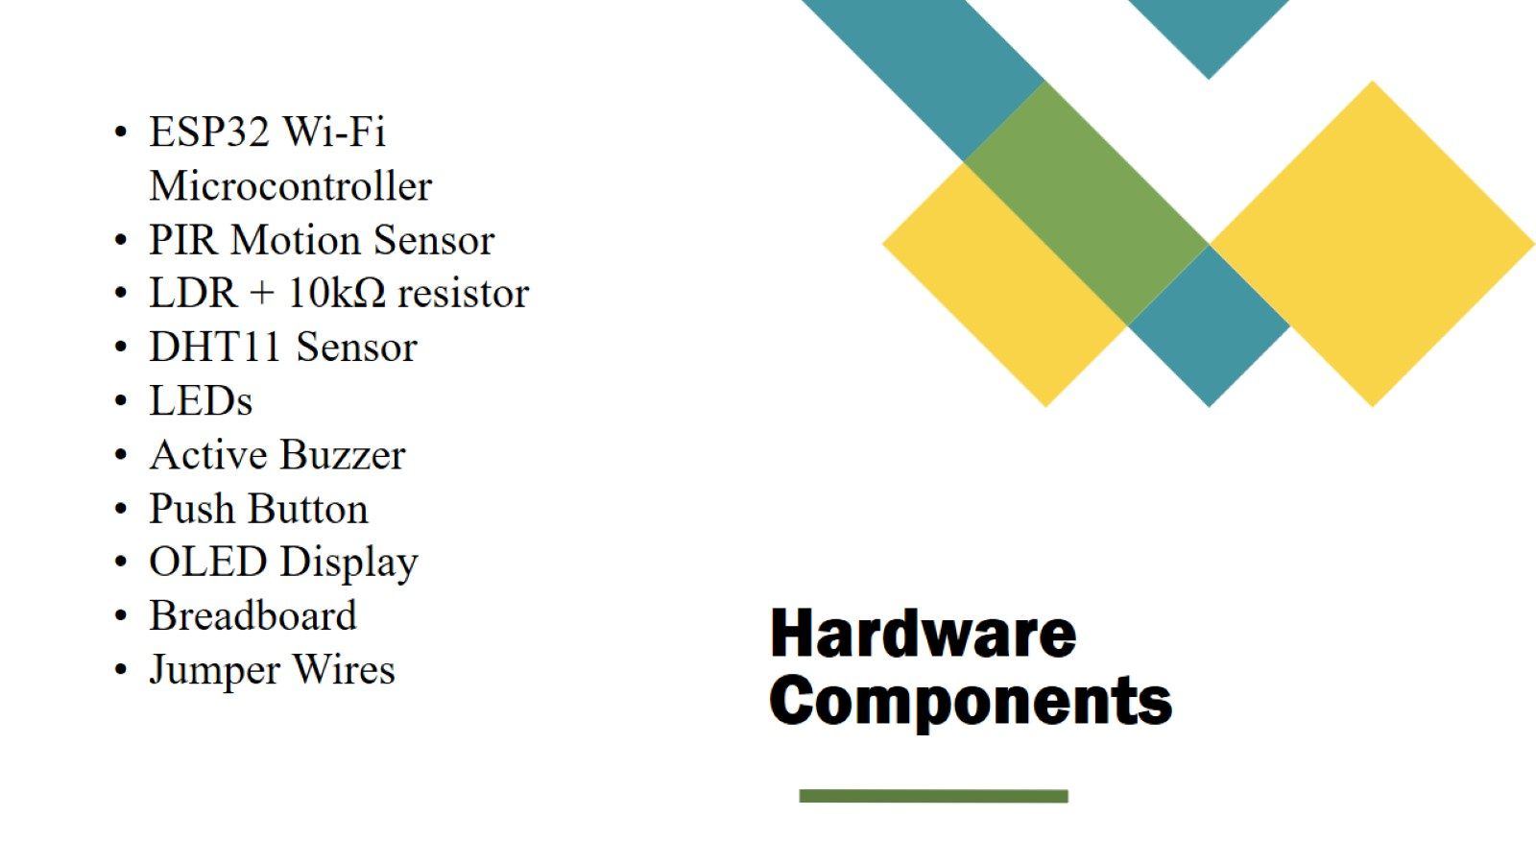
Hardware Components

Slide 9
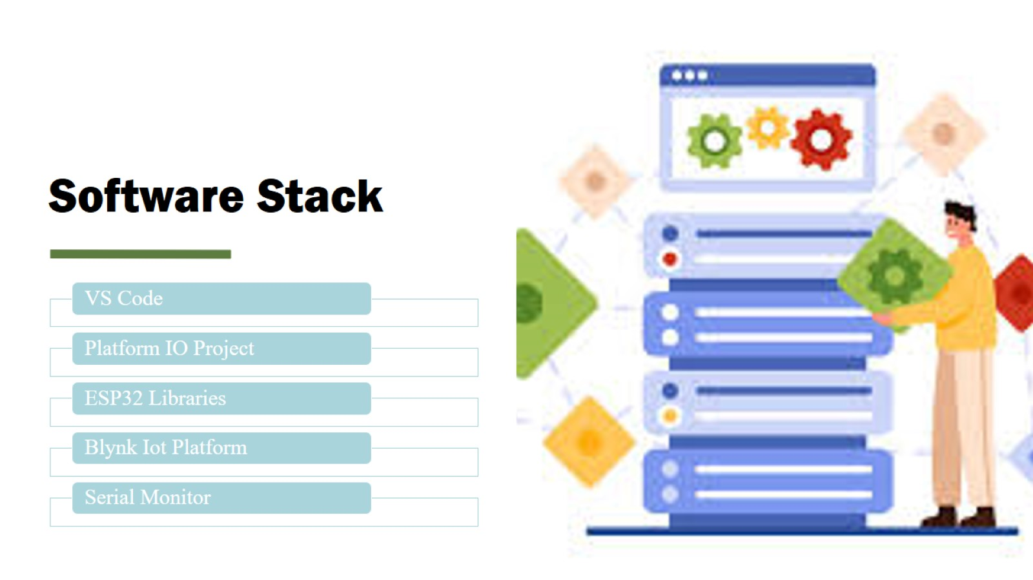
Software Stack

Slide 10
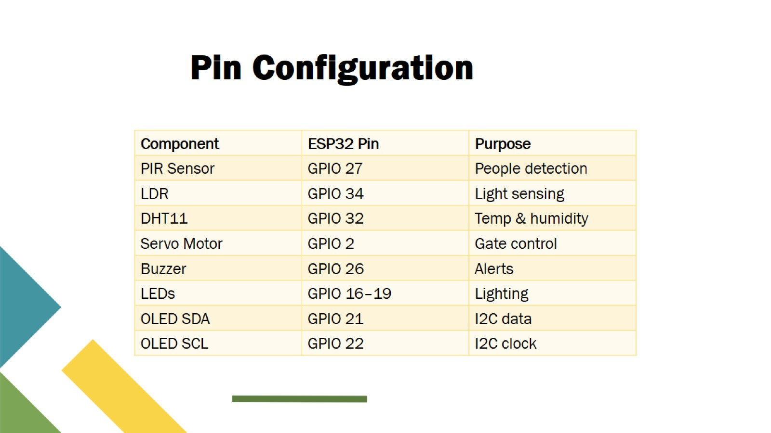
Pin Configuration

Slide 11
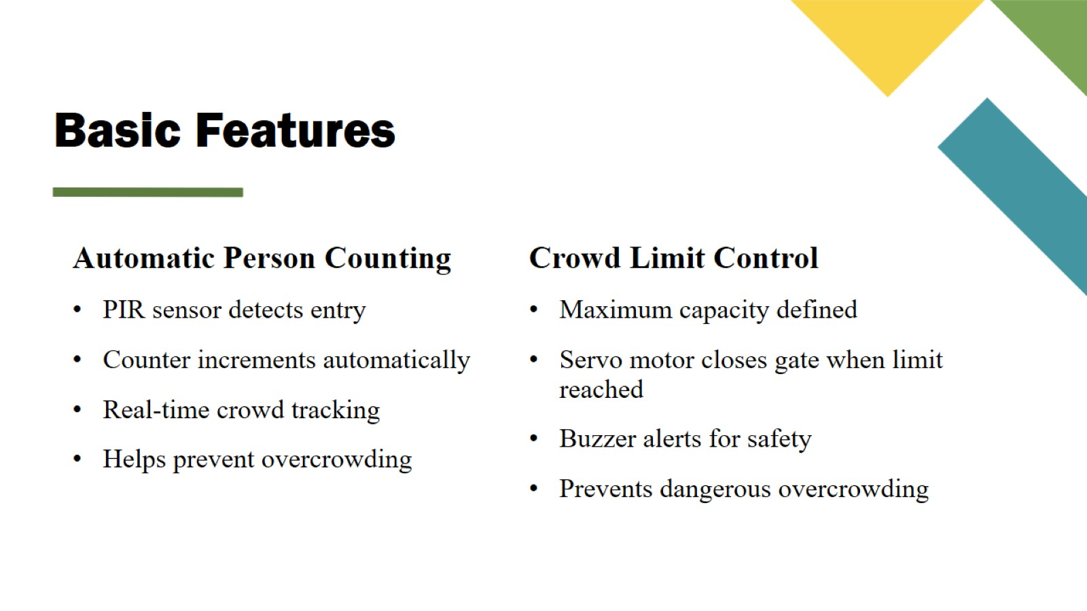
Basic Features

Slide 12
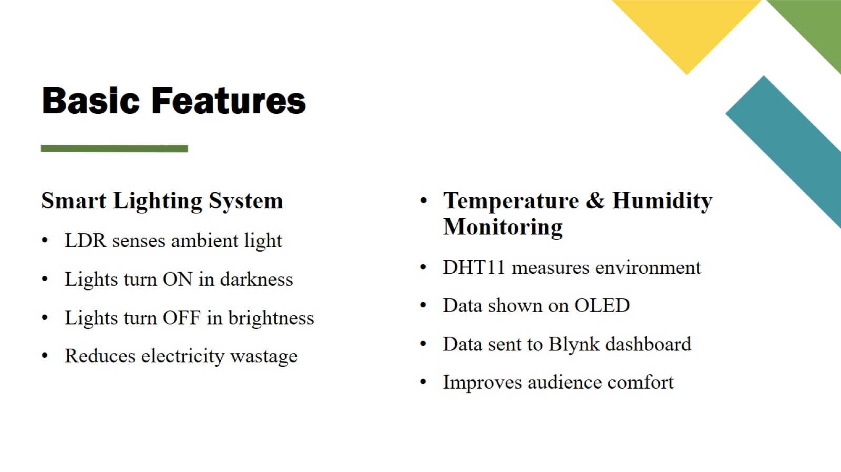
Basic Features

Slide 13
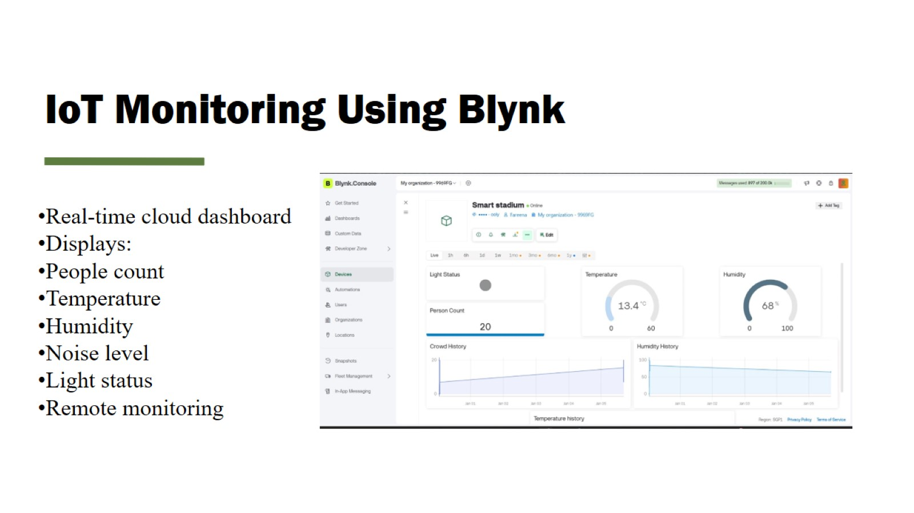
IoT Monitoring Using Blynk

Slide 14
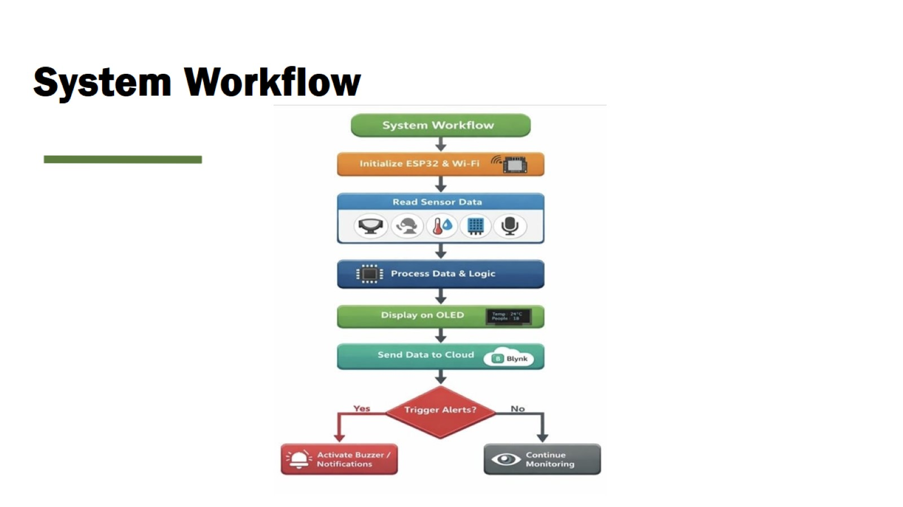
System Workflow

Slide 15
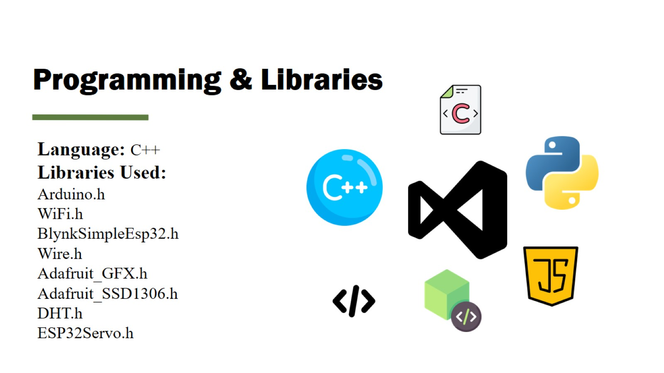
Programming & Libraries

Slide 16
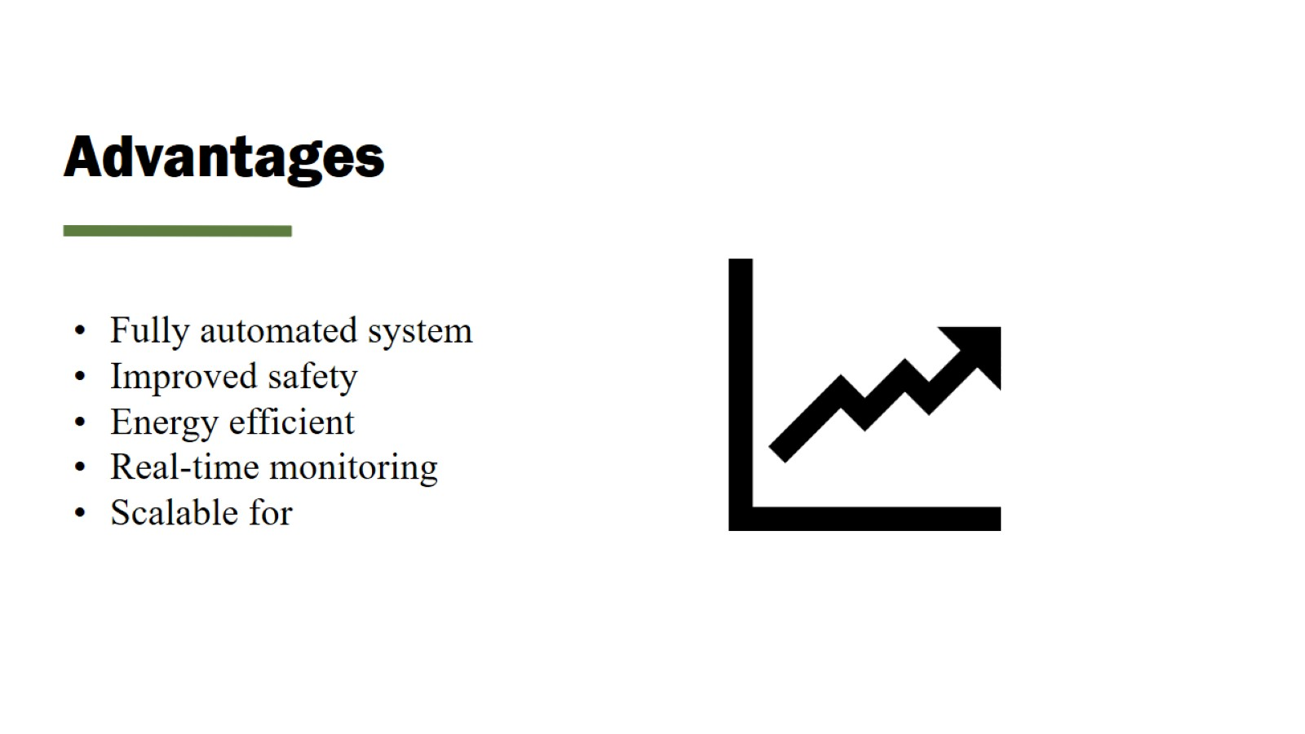
Advantages

Slide 17
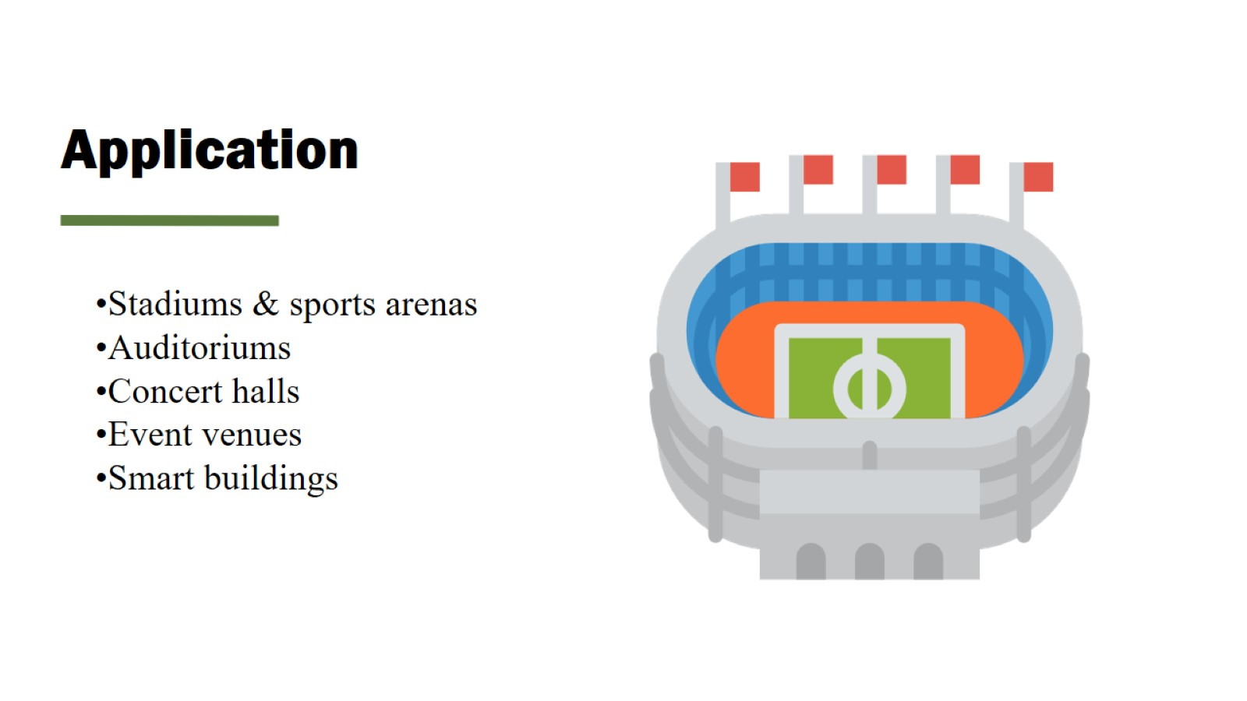
Application

Slide 18
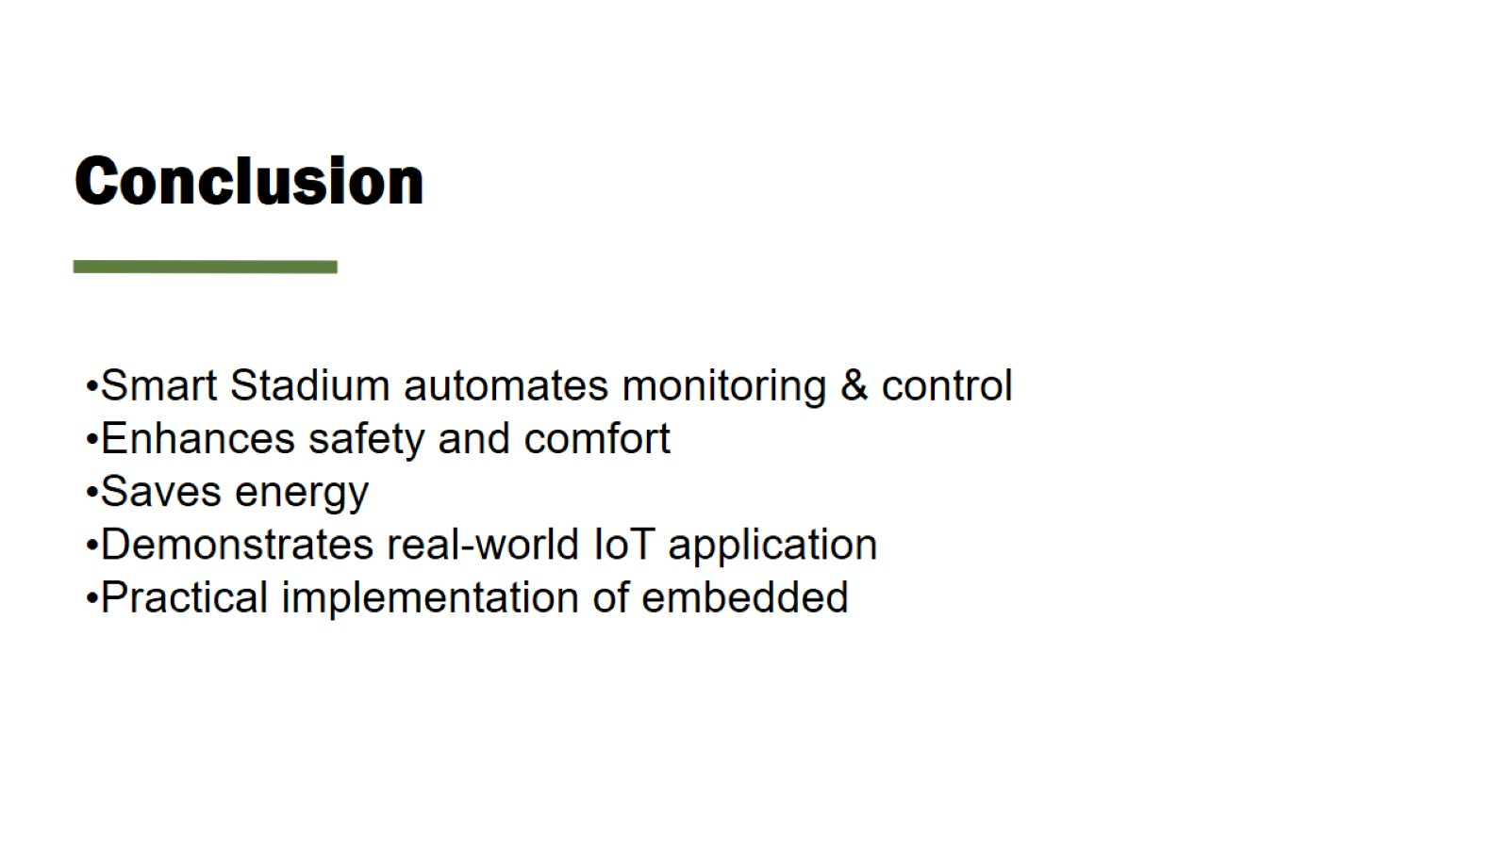
Conclusion

Slide 19

Thank You!

